Slide 1
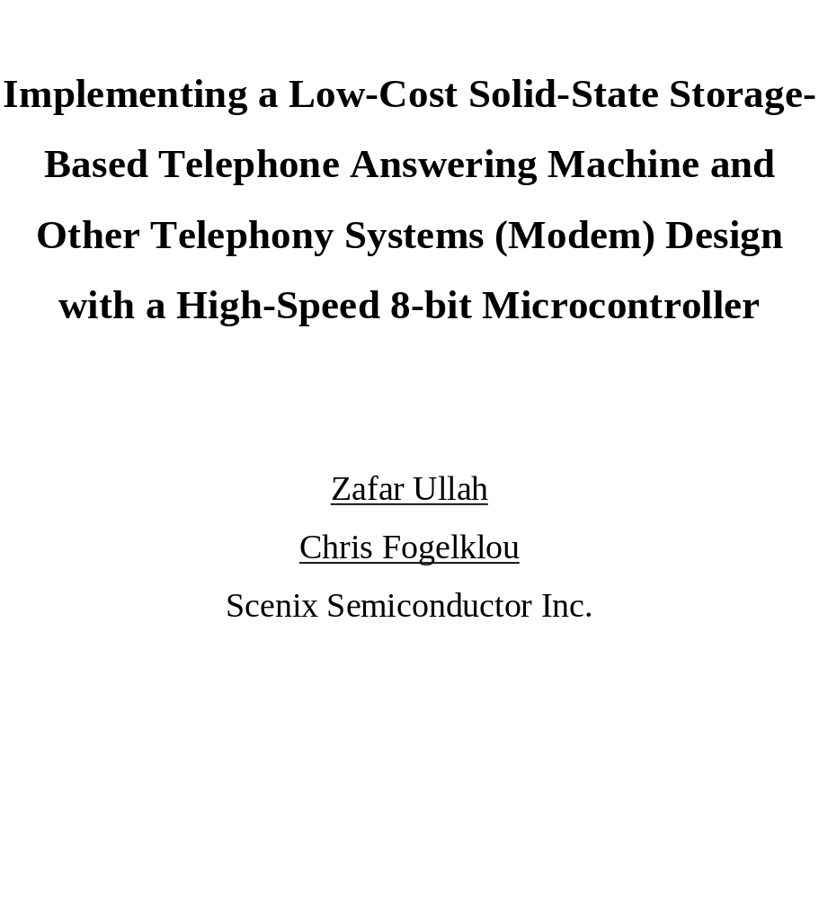

Slide 2
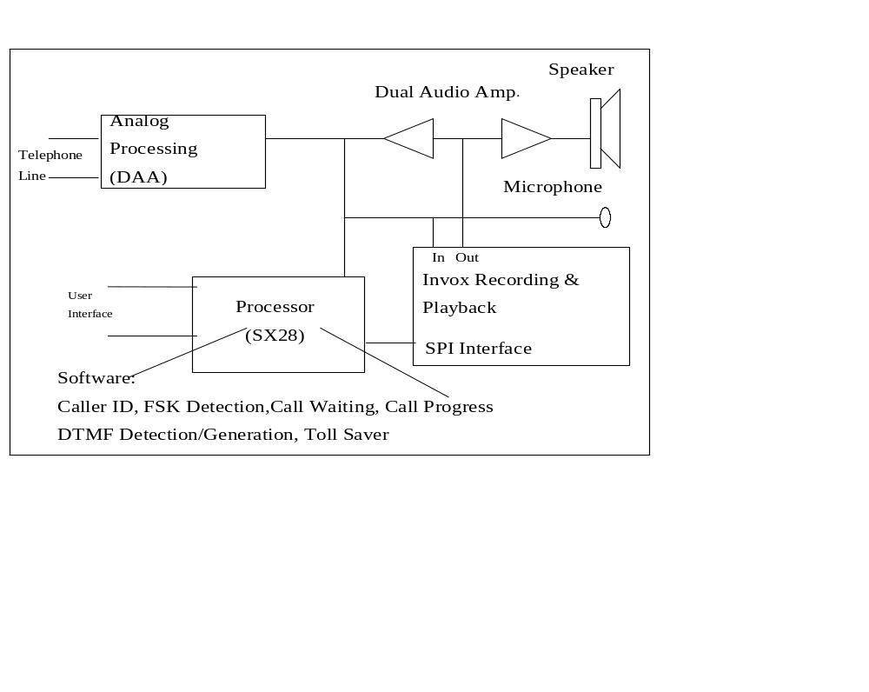
BASIC TAD BLOCK

Slide 3
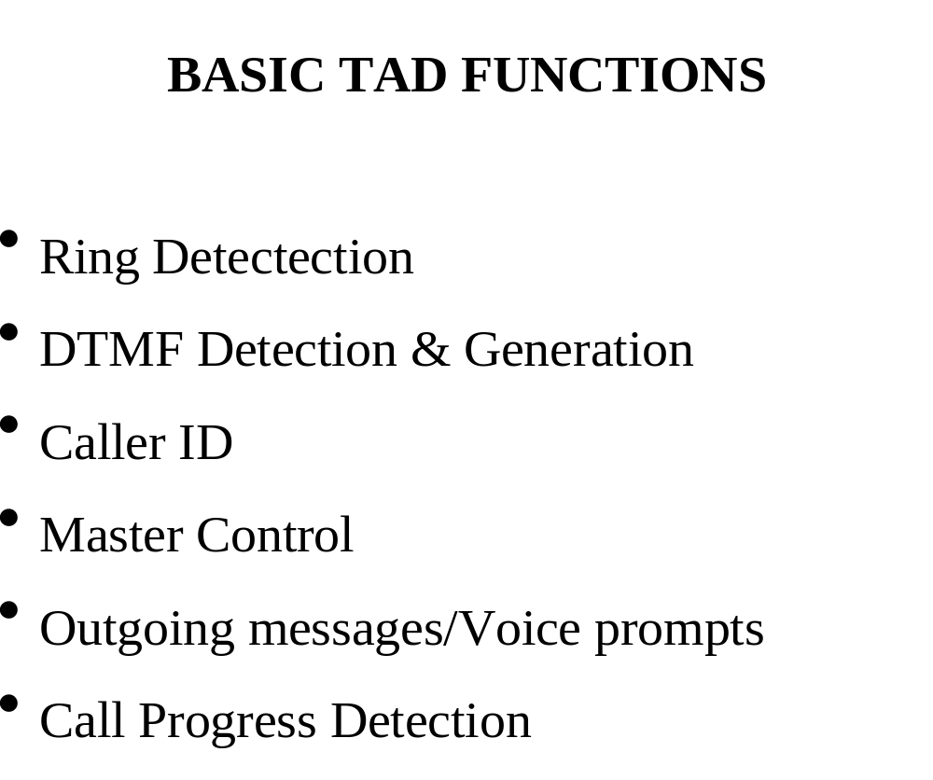

Slide 4
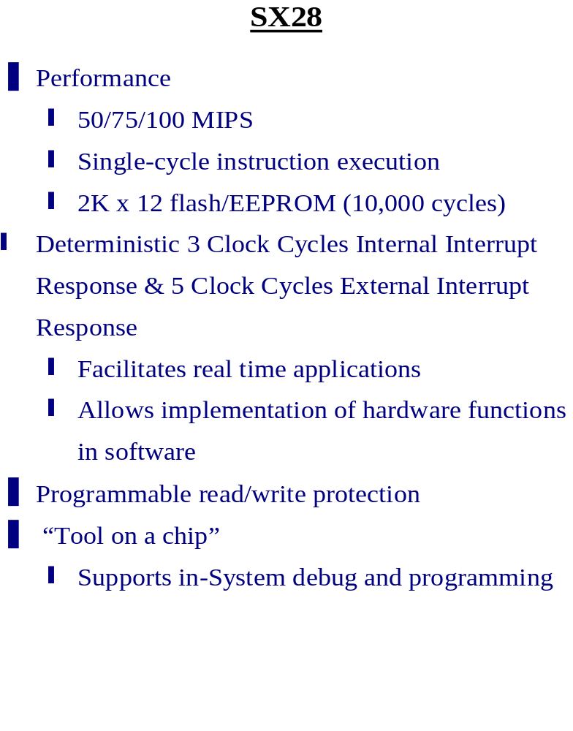

Slide 5
Conventional Solutions
Multi-chip solutions
Low-end DSP
Low-end FPGA
Multi-chip solutions
Mid-range DSP
Mid-range FPGA
16/32-bit MCUs
32/64-bit MCUs
High end DSP
High end FPGA
Performance
High-end 8-bit microcontroller
Low-end 16-bit microcontroller
8-bit MCU
Performance Barrier
4-bit MCU
System Complexity

Slide 6
Breaking The Performance Barrier
Multi-chip solutions
Low-end DSP
Low-end FPGA
Multi-chip solutions
Mid-range DSP
Mid-range FPGA
16/32-bit MCUs
Scenix
SX family
32/64-bit MCUs
High end DSP
High end FPGA
will replace
16 and 32-bit MCUs,
FPGAs and
mid range DSPs
Performance
High-end 8-bit microcontroller
Low-end 16-bit microcontroller
8-bit MCU
Performance Barrier
4-bit MCU
System Complexity

Slide 7
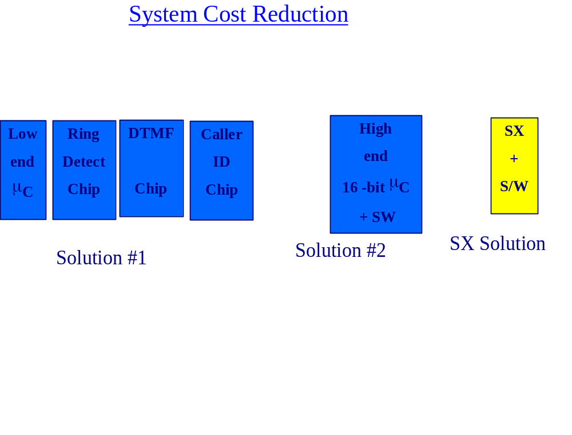

Slide 8
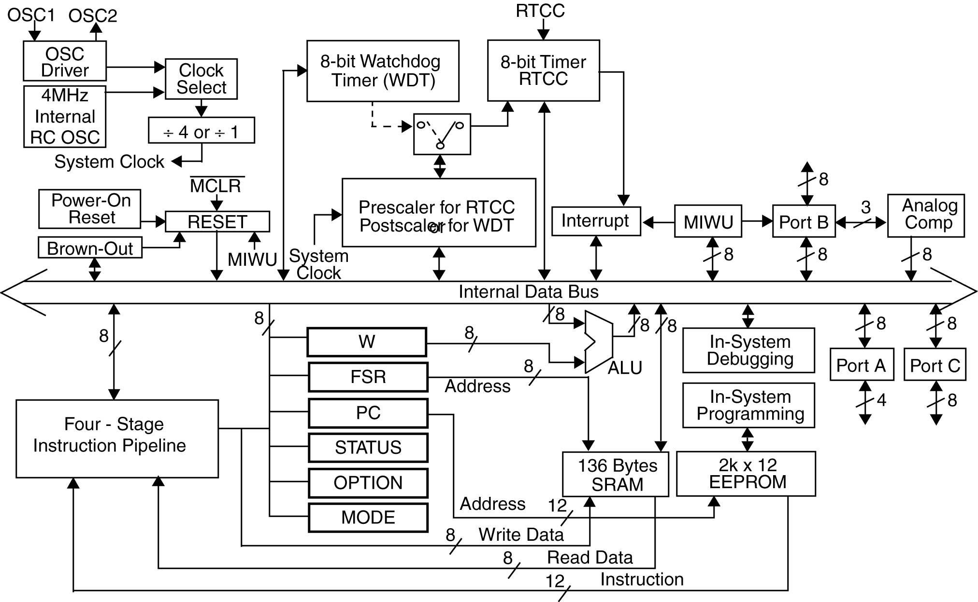
Block Diagram

Slide 9
SX PIPELINE
Fetch
Decode
Execute
Write
Back
12 bit
instruction word
4 stages
Provides high speed, single cycle instruction execution on most instructions

Slide 10
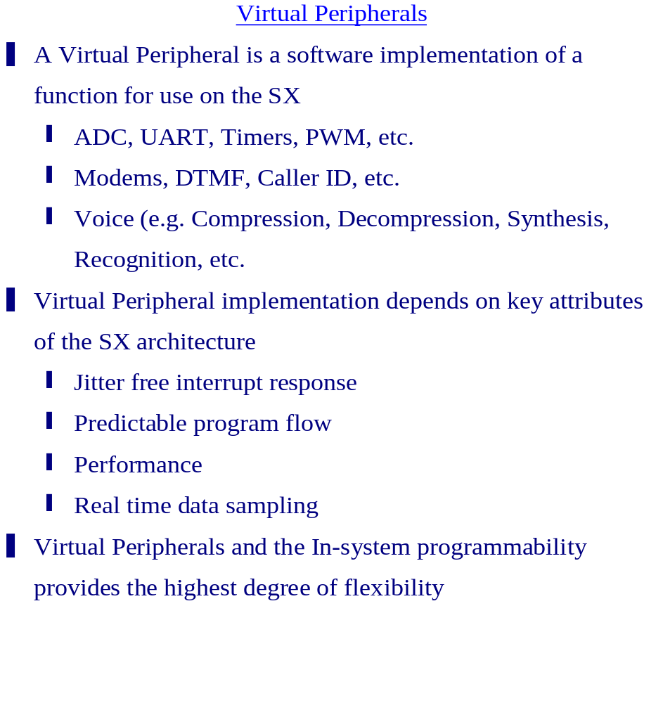

Slide 11
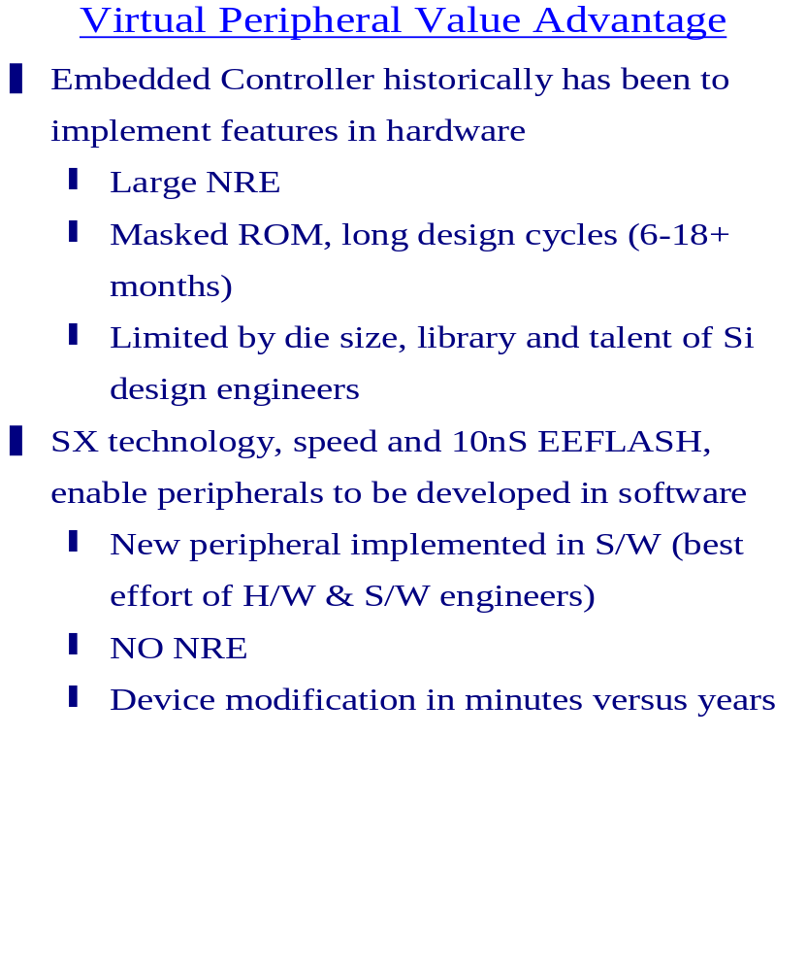

Slide 12
The Power of Virtual Peripherals
Analog line
Analog line
PWM
PWM
DTMF
Detection
A/D
Converter
FSK
Detection
Ring
Detect
DTMF
Generation
FSK
Generation
Oscillator
SX28AC
8-bit uC Core
Caller
ID
Osc.1
Osc.2
In-system
programming
Brown-out
Detection
16-bit
Timer 1
UART
SPI
Interface
2K*12
FLASH
136 B
SRAM
Vcc
To RS232
SPI bus
Hardware Blocks
Virtual Peripherals

Slide 13
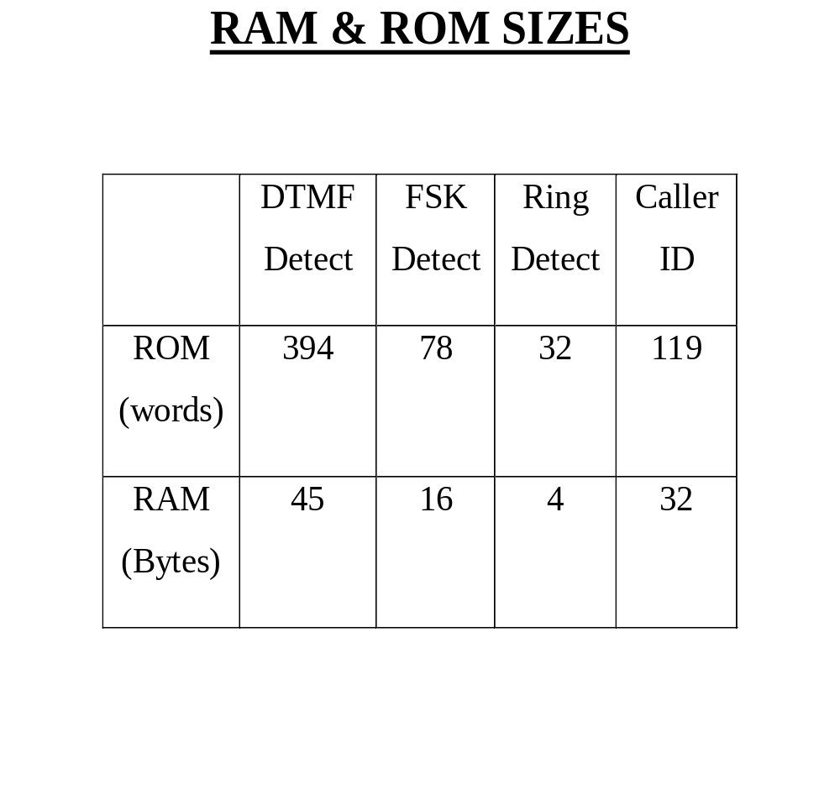

Slide 14
Core Technology
Multi-Level Cell (MLC) Storage
Precise analog voltage storage capability in Flash memory cells
Achieved through techniques for sampling, programming, storing, and sensing analog signal levels
Achieved 256 levels of programming each of 12.5mV resolution
  Equivalent to 8-bits of digital data
Utilizing industry standard Flash technology
  Cost effective for high-volume manufacturing

Slide 15
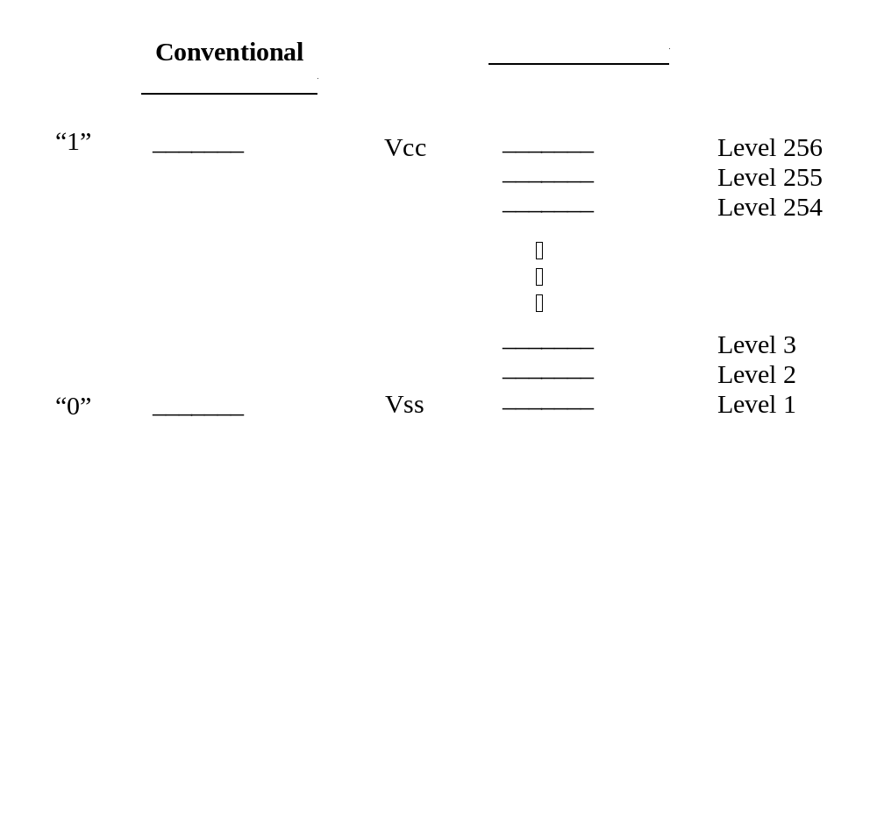
Multi-Level Cell Concept
Digital Information: 1 Bit/Cell N Bits/Cell (e.g. 8)
Analog Levels: 2 Levels/Cell 2^{N} Levels/Cell (e.g. 256)

Slide 16
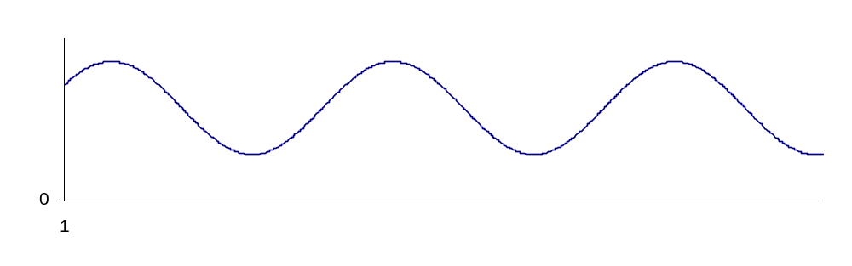
What is analog storage in flash?
The ability to precisely store the sampled value of an analog signal in a single flash memory cell. Each sample is stored in a unique cell.
The analog signal is sampled at a frequency based on the desired quality of reproduction of the signal

Slide 17
MLC Benefits
Higher quality speech recording and playback
Lower power consumption
  Longer battery life
Reduces the number of devices
  Lower cost
  Higher reliability
Higher bits-per-cell usage vs. digital memory
  Lower cost/per MCell

Slide 18
Flash MLC Storage for Speech Recording
Cost Effective
  Single chip solution with the lowest overhead
  Most efficient usage of each memory cell
  Requires less board space
Best Sound Quality
  Natural Sound
  No A/D, D/A, or data compression required
Very Low Power
  Critical for portable, battery-powered applications
Non-volatile
Compatible to real-time recording

Slide 19
Modem: Definition
Modem
  Modulator/Demodulator.
  Modulates digital signals onto an analog carrier and sends them over an analog communications link.
  Demodulates analog signals to recover the digital information.

Slide 20
Modulation Techniques
Frequency Shift Keying (FSK)
A logic level (1 or 0) is signified by a transmitted frequency. The V.23 standard transmits 2100Hz for a 0 and 1300Hz for a 1.
Phase Shift Keying (PSK)
Bit patterns are signified by a phase shift in a carrier frequency.

Slide 21
Modulation Techniques
Quadrature-Amplitude Modulation (QAM)
A combination of phase shift keying and amplitude modulation which can symbolize more bits/baud than standard PSK modulation

Slide 22
Modem: Other Definitions
Baud:
Number of transitions in carrier per second.
B/S or BPS:
Bits per second: Number of data bits transmitted per second
Bits per second can be equal to or greater than baud rate
Simplex:
A one-way communications path.

Slide 23
Modem: Other Definitions
Half Duplex:
A two-way communications path.
Only one modem can transmit at a time.
Full Duplex:
A two-way communications path.
Each modem can transmit and receive simultaneously.

Slide 24
Choosing the Modem Solution
Why would anyone use a microcontroller to embed a modem?
  Sometimes a lower modem speed is worth the extra cost savings.
  Integrating telephony functionality into embedded system controller software allows extra functionality for lower cost.
  Necessary external circuitry is very simple for low-speed applications.
    Op-amps, resistors, capacitors.

Slide 25
Lower-Speed Modem Standards
These lower-speed modem standards are the most likely to be implemented in an 8-bit micro.
Bell 103/V.21
  A 300-b/s full-duplex FSK modem standard.
  Most modems will support Bell103 in a fallback mode
Bell 113
  A 300-b/s, asynchronous, full-duplex, FSK modem standard.
Bell 201
  A 2400 b/s, synchronous, full-duplex, DPSK modem standard

Slide 26
Lower-Speed Modem Standards
Bell 202
  A standard for half-duplex data transmission at 1200b/s using FSK modulation.
Bell 212
  - A standard for 1200 b/s full-duplex modems using DPSK modulation on dial-up lines.
V.22/Bell 212A
  A full-duplex 4PSK modem standard that operates at 1200b/s and 600baud. The North American version is Bell212A.

Slide 27
Lower-Speed Modem Standards
V.22 bis
  - A full-duplex QAM modem standard that operates at 2400b/s and 600 baud.
V.23
  - A full-duplex FSK data transmission standard allowing 1200 b/s on the forward channel and 75b/s on the back channel. Many modems still support the V.23 protocol.
V.32
  A full-duplex QAM modem standard that operates at 9600 b/s and 2400 baud.

Slide 28
Modem-in-Software Applications
Perfect applications for embedded, low-speed modem software:
  Answering Machines (DTMF detection, DTMF generation, Caller-ID detection, Call-Progress detection, System Control)
  Remote data acquisition (DTMF generation, FSK generation, FSK detection, System Control)
  Custom, proprietary, or obsolete protocols (HART, TDD, BELL202)

Slide 29
Telephony: Signal Generation
Sine Wave Generation
using a Phase Accumulator

Slide 30
Telephony: Signal Generation
  Two key variables:
    phase_acc
      phase accumulator.
    freq
      constant that is added to the phase accumulator on every sample.
  freq = (2^{n} * Fs⁻¹ * desired frequency) where n is the number of bits in the phase accumulator and Fs is the sample rate.
  MSBs of phase_acc is an index into a table of sine wave values. The more bits used, the greater the resolution.
Notes:
For example, to generate a frequency of 697 Hz, with a sample rate of 19200Hz and 16-bit phase accumulators and freq variables,
freq = 2^16 * (1/19200) * 697Hz
freq = 2379.09
Convert 2379.09 to hexadecimal
freq = 0x094b
To calculate how accurate the output frequency will be:
2379 / (2^16 * (1/19200) = 696.97Hz

Slide 31
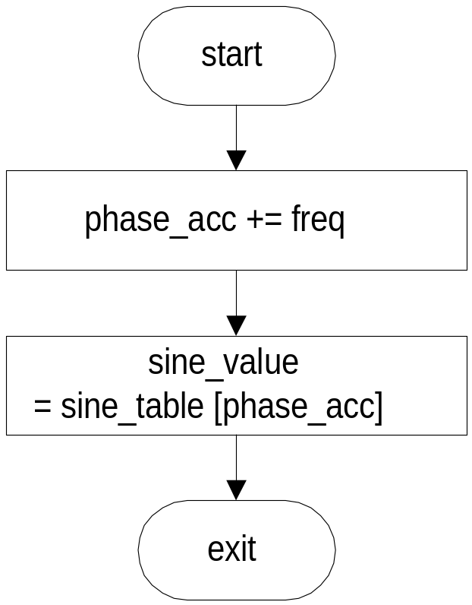
Telephony: Signal Generation
Phase accumulator
flowchart for each
sample
EXAMPLE ASSEMBLER CODE
; 16-bit add to phase accumulator
add phase_acc_l,freq_l
snc ; if carry, increment upper byte
inc phase_acc_h
add phase_acc_h,freq_h
; use upper nybble of phase
; accumulator as index into sine
; table.
mov w,phase_acc_h
swap wreg ; swap nybbles of w
and w,#$0f ; keep the lower nybble
call sine_table; get sine value
; store new amplitude into D/A register
mov D_to_A_val,w
Notes:
To produce each new sample of the sine wave, the freq variable is added to the phase accumulator, and the resultant new phase is used as an index into a table of sine values.
Use the upper bits of the phase accumulator as an index. For example, if the application only requires 4-values, use only the upper two bits (AND with 0xC000)
For a 256 value table, use the upper byte as the index.

Slide 32
Telephony: Signal Generation
EXAMPLE SINE TABLE
;*****************************
sine_table
; returns with values in the
; range of +/- 32 in the w
; register. Uses w register
; as an index into the table
;*****************************
jmp pc+w retw 0
retw 12
retw 23
retw 30
retw 32
retw 30
retw 23
retw 12
retw 0
retw -12
retw -23
retw -30
retw -32
retw -30
retw -23
retw -12
;*****************************
Notes:
This sine table contains only 16 values, but the wave-form produced is still adequate for many telephony applications.
Since all values in the table correspond to an input phase, shifting the phase of a signal is simply a matter of adding or to the index before using it to retrieve a value.
For instance, to shift this sine wave by 90 degrees, you would add (1/4 + 1) of the full scale index to the index before calling the table, or:
index = ((index + 4) && 0x0f)

Slide 33
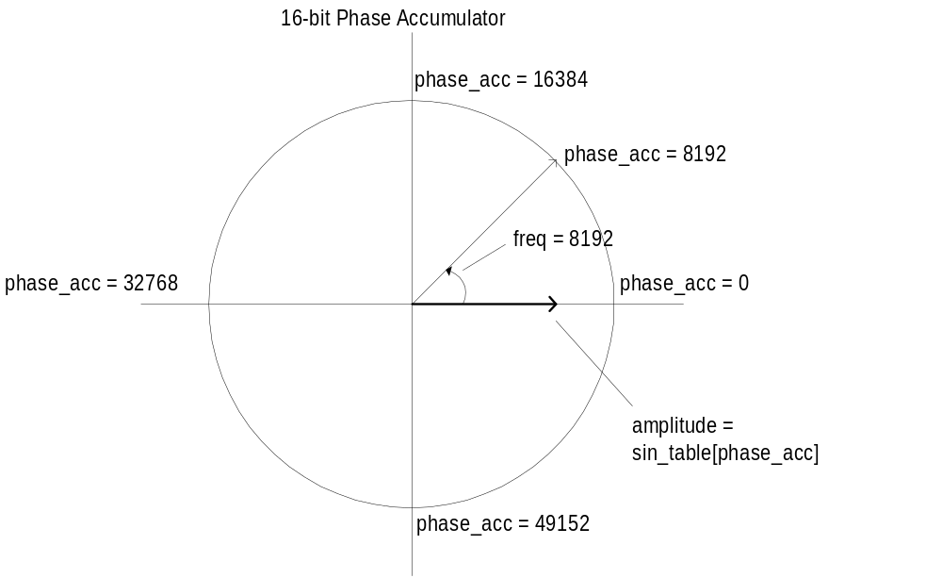
Telephony: Signal Generation
Notes:
As shown in this diagram, the value in the freq variable is 8192.
On every sample, the phase is advanced by 8192.
The value 65536 lies where 2*pi would be, and this is the point at which the sine wave repeats itself.

Slide 34
Telephony: Signal Generation
FSK Generation:
A Real World Application

Slide 35
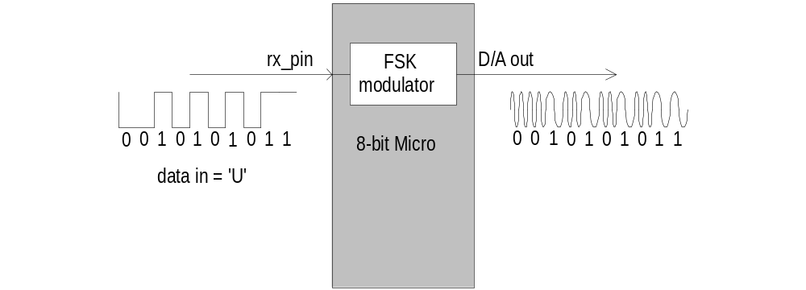
Telephony: Signal Generation
FSK Generation:
A simple FSK implementation is to simply modulate the serial data on an RS-232 receive pin into an FSK signal.
Notes:
Since we assume that the data present at the rx_pin has already been formatted to some serial protocol, no processing is required to synchronize with it.
A 1200bps bitstream with no parity and 8-data bits will still be a 1200bps, N, 8, 1 bitstream in the modulated output.
If we wish to generate the bitstream internally in the microcontroller, we need to embed a software UART in the controller code to perform the timing for the FSK transmission.

Slide 36
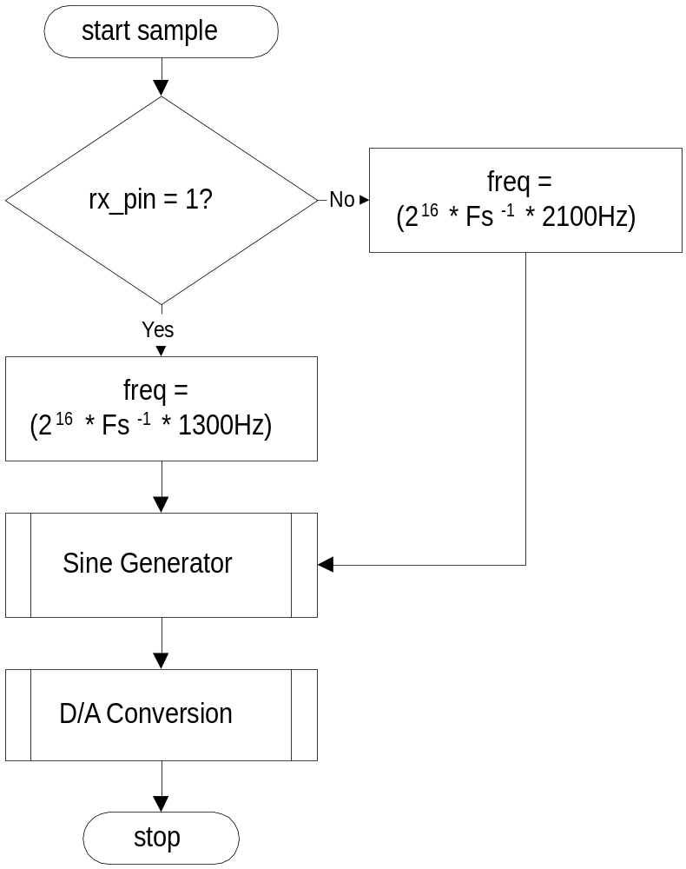
Telephony: Signal Generation
FSK Generation:
This simple software flowchart accomplishes the task of modulating the data on the serial input pin into an FSK signal.
Notes:
Simplified flowchart for modulating a bitstream on a serial input pin onto an output, using the previously specified sine-wave generation method.

Slide 37
Telephony: Signal Generation
DTMF Generation:
Another Real World Application

Slide 38
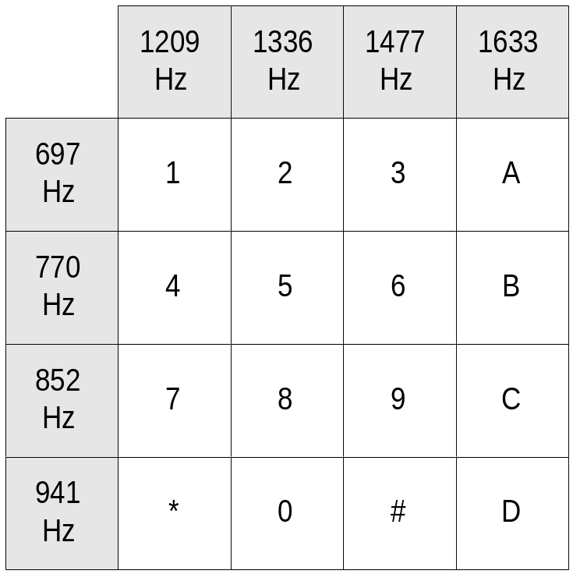
Telephony: Signal Generation
DTMF:
Dual-Tone Multiple Frequency
DTMF uses a combination of two frequencies to encode each digit to dial.
For instance, to dial a ‘1’, generate 697Hz in combination with 1209Hz.
Layout of a telephone keypad

Slide 39
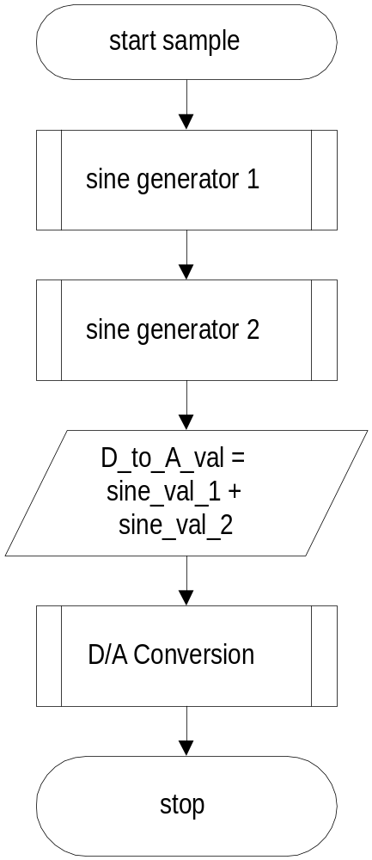
Telephony: Signal Generation
Generating DTMF
Generating DTMF is simply a matter of summing the outputs of two sine-generator routines to produce each sample.
Notes:
Simplified flowchart for generating a DTMF waveform.
In a practical application, D_to_A_val will need to be offset by 1/2 full-scale, since the algorithms shown in this document for D/A conversion require values that range from 0 to 255, not -128 to 127 as is shown in this document.

Slide 40
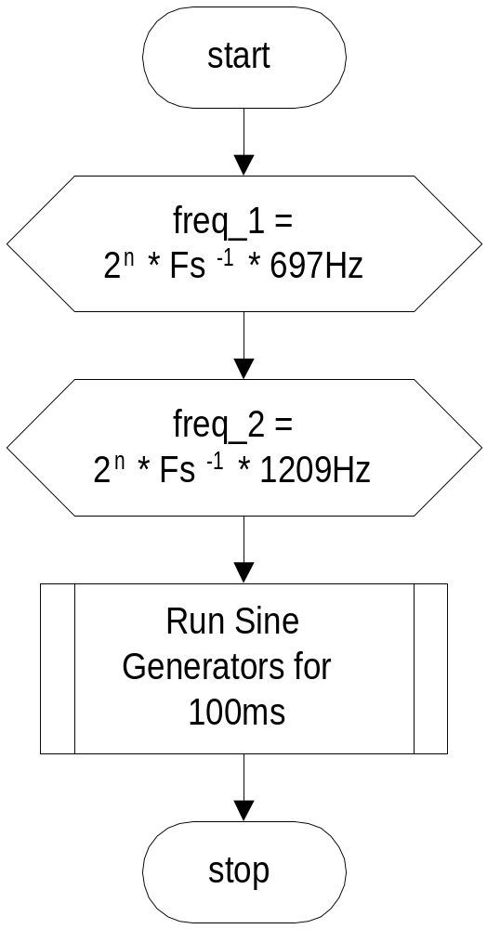
Telephony: Signal Generation
Generating DTMF
For instance, to dial a ‘1’ for 100ms:
Initialize the freq registers for each sine generator.
Run the sine generators at the sampling frequency for 100ms.
Disable the sine generators

Slide 41
Telephony: Signal Generation
D/A Conversion Techniques
Interfacing the Software to the Real World.

Slide 42
Telephony: Signal Generation
D/A Conversion Techniques
Hardware D/A Converter
Advantages
    Low I/O pin usage (serial D/A)
    Known Specifications
    Higher accuracy than most software techniques.
Disadvantages
    If it is not built into the microcontroller, it is much more expensive than R-2R or PDM/PWM solutions.
    Medium Software implementation (usually serially interfaced)

Slide 43
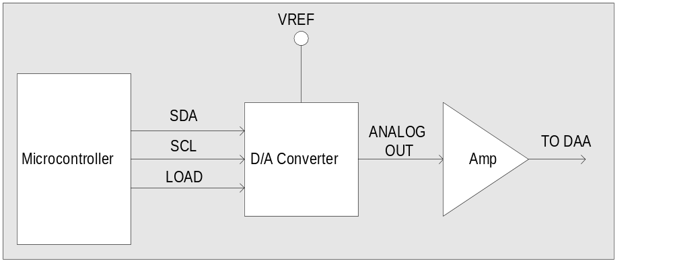
Telephony: Signal Generation
D/A Conversion Techniques
Hardware D/A Converter

Slide 44
Telephony: Signal Generation
D/A Conversion Techniques
R-2R Ladder
Advantages
    Minimal software implementation.
    Lower cost than hardware D/A converter.
    Faster and more accurate than software PWM/PDM solution.
Disadvantages
    Higher cost than PWM/PDM implementation due to more circuitry.
    Requires 1 I/O pin per bit of resolution.
    MSB needs to be very accurate (+/- 256⁻¹ for a practical 8-bit D/A.)

Slide 45
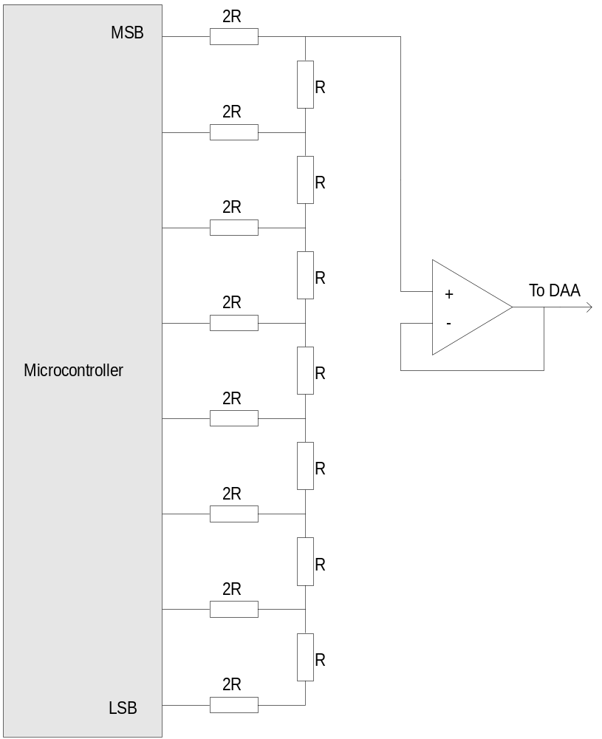
Telephony: Signal Generation
D/A Conversion Techniques
R-2R Ladder
This circuit uses discrete components to generate an output that is proportional to the weighted sum of the input voltages.
One output pin is required for each bit of the conversion, so for an 8-bit D/A conversion, 8 pins on the microcontroller are required.

Slide 46
Telephony: Signal Generation
D/A Conversion Techniques
PWM/PDM Generation
Advantages
    Minimal software implementation.
    Lowest cost of all solutions.
    Requires only a single output pin.
Disadvantages
    Needs high-speed processor with deterministic interrupt structure to run in background.
    Not suitable for high-sample-rate audio or high-resolution audio.

Slide 47
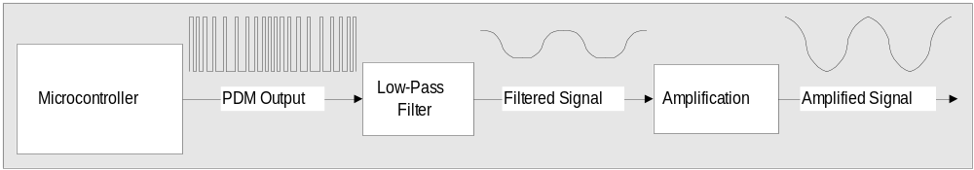
Telephony: Signal Generation
D/A Conversion Techniques
PWM/PDM Generation
Pulse Density Modulation Block Diagram

Slide 48
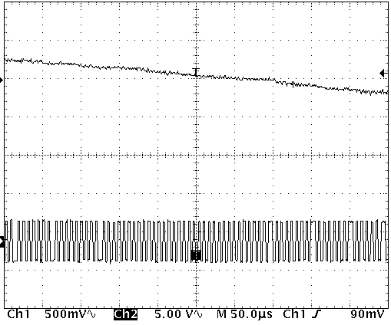
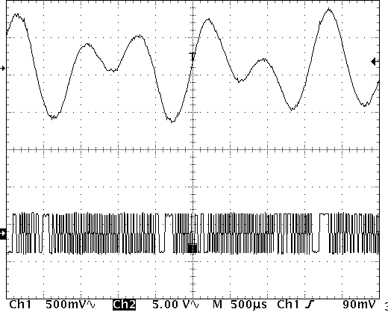
Telephony: Signal Generation
PDM output used to create a DTMF signal
Integrating PDM output creates an analog signal

Slide 49
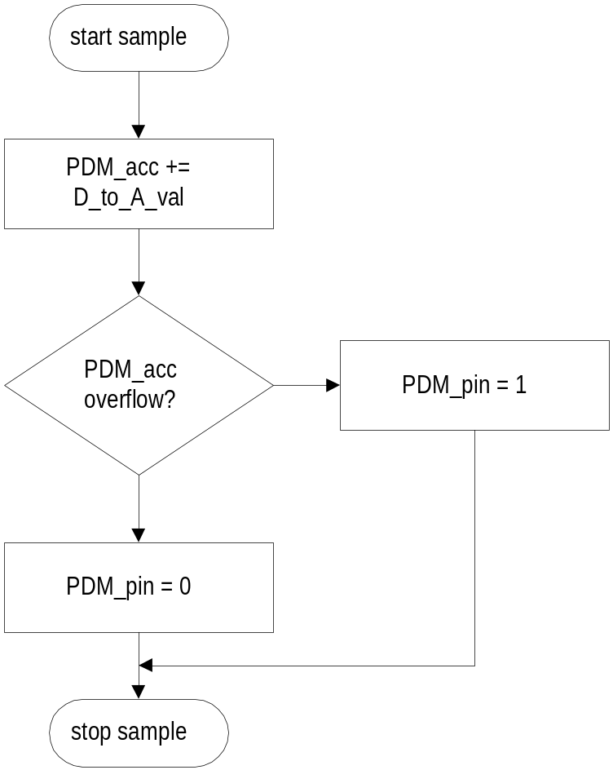
Telephony: Signal Generation
D/A Conversion Techniques
PWM/PDM Generation
PDM_pin is set if adding the 8-bit D_to_A_val to the 8-bit PDM_acc register causes an overflow.
Notes:
This is a flowchart for generating a PDM signal. It assumes that PDM_acc and D_to_A_val are both 8-bit values.
Example of use: If PDM_acc starts out at zero and we run the routine 256 times for an 8-bit resolution value:
If D_to_A_val = 255: PDM_acc won't roll over on the first pass so we will get an output of zero on the PDM pin. The remaining 255 samples will all overflow and the PDM pin will be set 255/256 of the time.
If D_to_A_val = 128: every second add will cause an overflow and the PDM pin will be set 128/256 of the time
If D_to_A_val = 1: Only the very last addition will cause an overflow, meaning that the PDM pin will only have been set 1/256 of the time.

Slide 50
Telephony: Signal Generation
D/A Conversion Techniques
PWM/PDM Generation
Pulse Density Modulation Example Assembly Code
;*********************************************************************
D_to_A_OUTPUT
; This outputs a digital value equivalent to the value in D_to_A_val
; the Pulse Density Modulation pin.
;*********************************************************************
bank D_to_A_bank
add PDM_acc,D_to_A_val
snc
setb PDM_pin
sc
clrb PDM_pin
D_to_A_out
ret ; return
;*********************************************************************

Slide 51
Telephony: Signal Detection
Signal Detection:
Decoding FSK

Slide 52
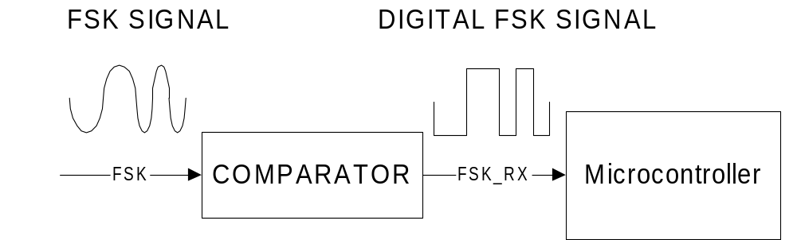
Telephony: Signal Detection
A zero-cross algorithm is the easiest way to demodulate an FSK into its original data stream.
Run the modulated analog input through a comparator so that only transitions are detected.
Use transition time to determine the current input frequency.
Translate input frequency to an output voltage.
  Example: 5V for 1300Hz and 0V for 2100Hz for V.23 reception.

Slide 53
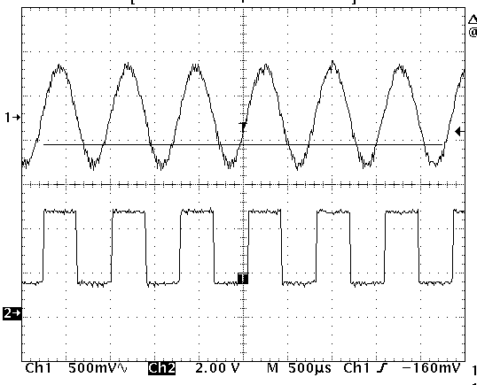
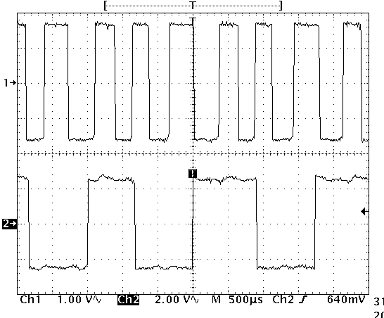
Telephony: Signal Detection
From which the original data-stream can be digitally restored.
The analog signal is first passed through a comparator to create a zero-cross signal….

Slide 54
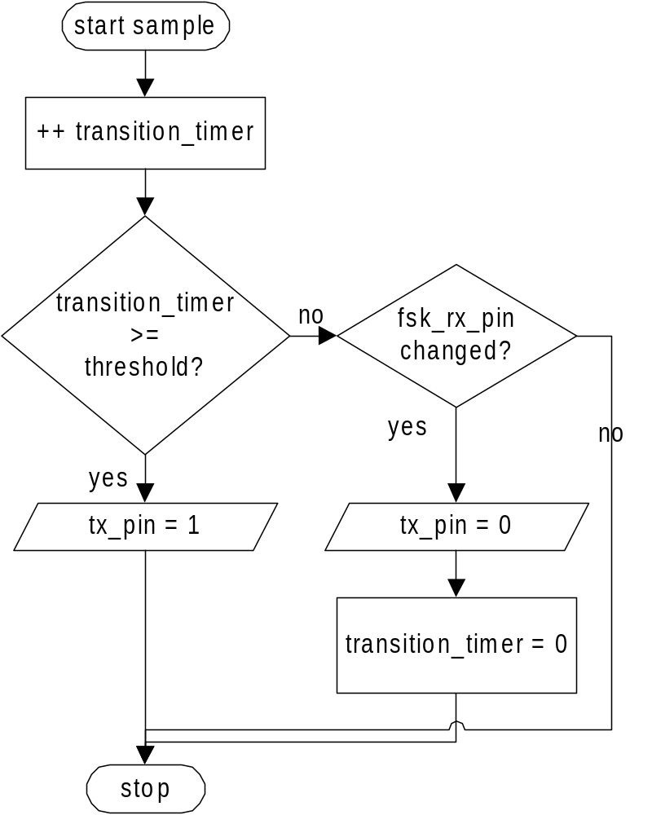
Telephony: Signal Detection
Simplified Algorithm for Zero-Cross FSK detection.
Increment the transition timer on every sample.
If timer has surpassed the threshold between high and low frequencies, set the transmit pin.
Else, if the input pin has changed state, clear the transmit pin.
This flowchart is simplified. It fails to ignore any glitches that may occur on the input, which cause a transition time that is well below the threshold between high and low frequencies.

Slide 55
Telephony: Signal Detection
Telephony:
Example Hardware
The following hardware is from an actual implementation of a software V.23 modem.

Slide 56
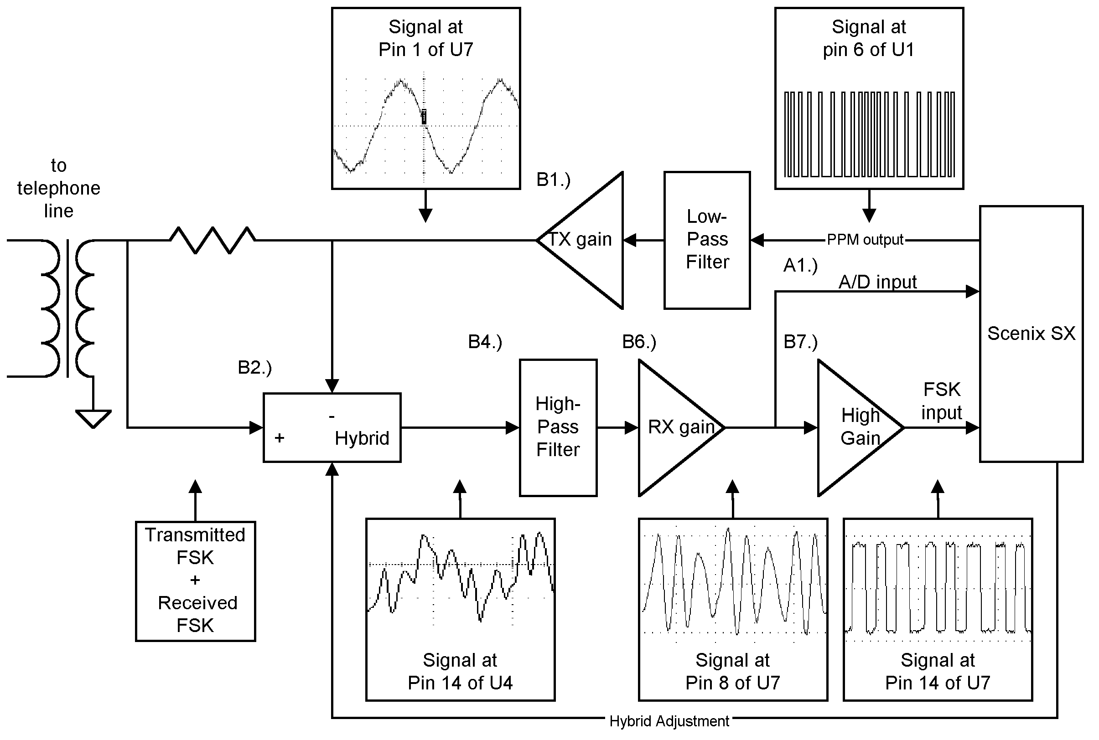
V.23 Hardware Block Diagram

Slide 57
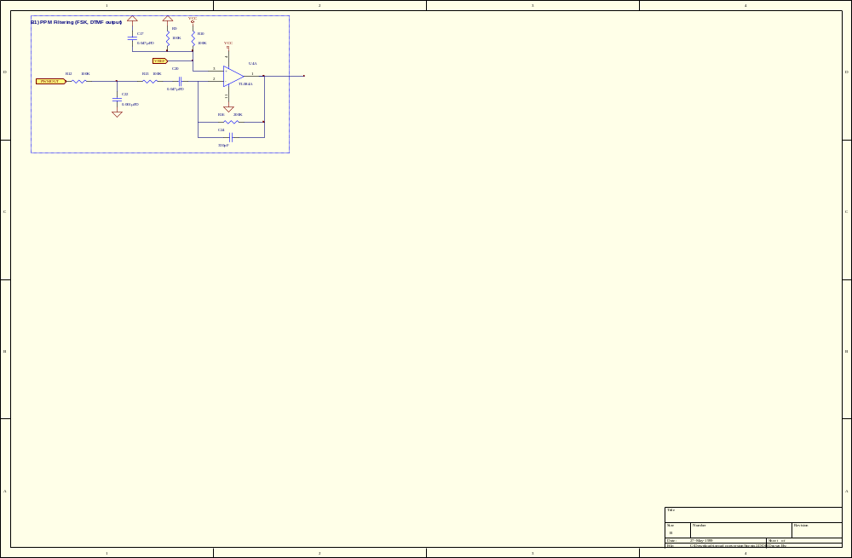
V.23 Hardware: PPM Filtering
2nd-Order-Filtering uses a single op-amp.
Cut-Off Frequency ≅ 3kHz

Slide 58
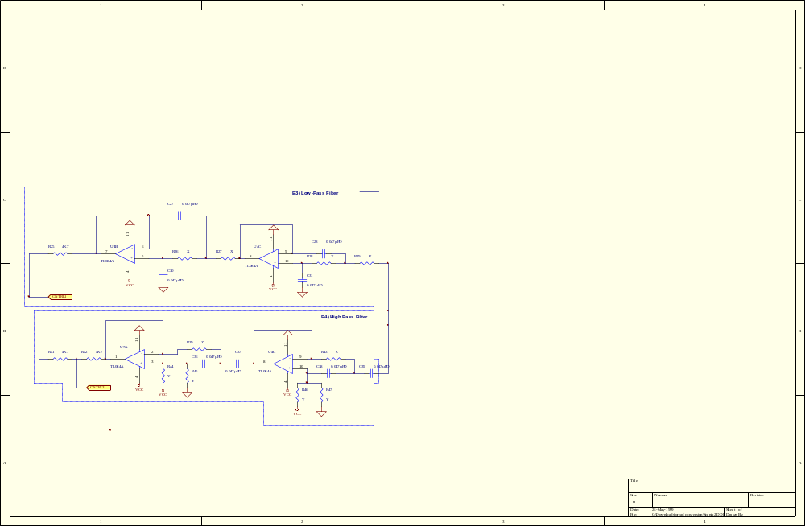
V.23 Hardware: Filtering
High Pass Filtering removes remaining transmitted signal from received FSK signal
4th-Order-Filter uses only 2 op-amps
Cut-Off frequency ≅ 1200 Hz

Slide 59
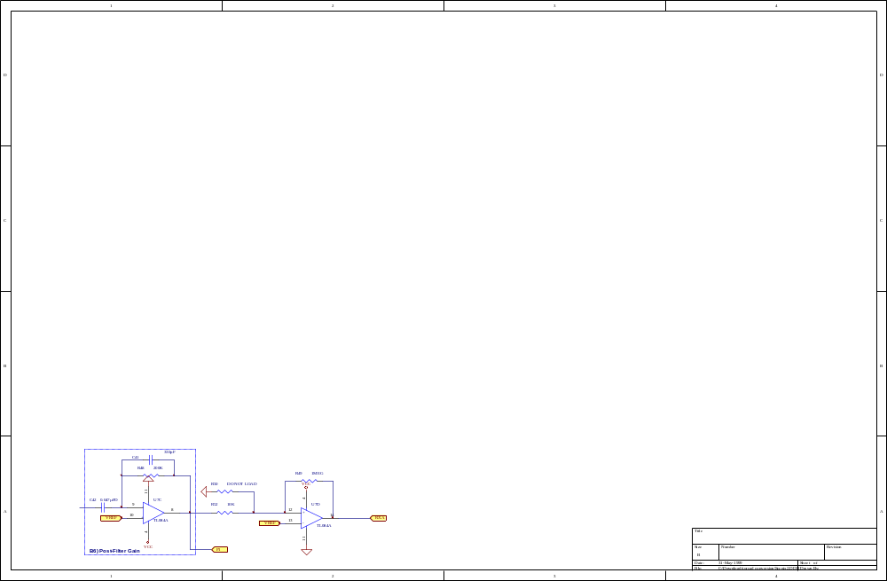
V.23 Hardware: Comparator
Digital FSK
OUT
Amplification stage has Gain ≅ 20
Amplification and Comparator use only 2 op-amps
Comparator converts analog signal to digital signal, for reception by Scenix SX

Slide 60
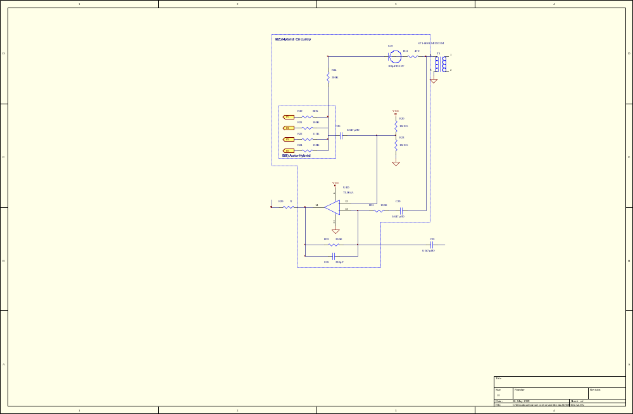
V.23 Hardware: Hybrid
Hybrid removes transmitted signal from received signal.
Individually selectable line impedances:
  450 ohms
  600 ohms
  750 ohms
  900 ohms
Hybrid uses only one op-amp

Slide 61
Telephony: Signal Detection
Caller-ID Detection.
Class 1 Caller-ID is modulated in V.23 format, 1300Hz for a mark (logic ‘1’) and 2100Hz for a space (logic ‘0’)
1200bps, no parity, 7 data bits, 1 stop bit data-stream.
Caller-ID signal appears between 1st and 2nd ring in North America.
Beginning of Caller-ID signal is indicated by several consecutive 0x55 bytes.
Each string preceded by a “format” byte.
For example:
  0x01 or 0x04 = date & time
  0x02 = phone number
  0x07 = name of caller
Each string preceded by a “length of string” byte

Slide 62
Telephony: Signal Detection
Caller-ID Detection.
Example RAW Caller-ID in “Date, Time, Number” format:
...55,55,55,55,04,12,30,32,32,38,31,34,33,34,34,30,37,35,35,35,37,37,37,37...
Example Caller-ID with significant numbers converted to ASCII:
…55, 04, ”0, 2, 2, 8, 1, 3, 3, 4, 4, 0, 7, 5, 5, 5, 7, 7, 7, 7 ”…
Example formatted Caller-ID:
Date - Feb 28, Time - 1:34pm, Number - (407) 555-7777

Slide 63
Telephony: Signal Detection
Implementing Caller-ID Detection.
Type-I caller-ID signal can be demodulated the same way a V.23 signal is demodulated, using the same zero-cross algorithm.
The circuitry for detecting caller-ID is simplified when compared to the same circuitry for the FSK modem solution because there is no transmitted signal to remove from the received signal.
To decode the caller-ID in software,
  link a software UART to the demodulated caller-ID bit-stream
  Synchronize with the stream of 0x55 bytes and wait until they are finished.
  Buffer the incoming characters (64 bytes is usually enough.)
  Format the Caller-ID data in the buffer by looking at the header bytes.

Slide 64
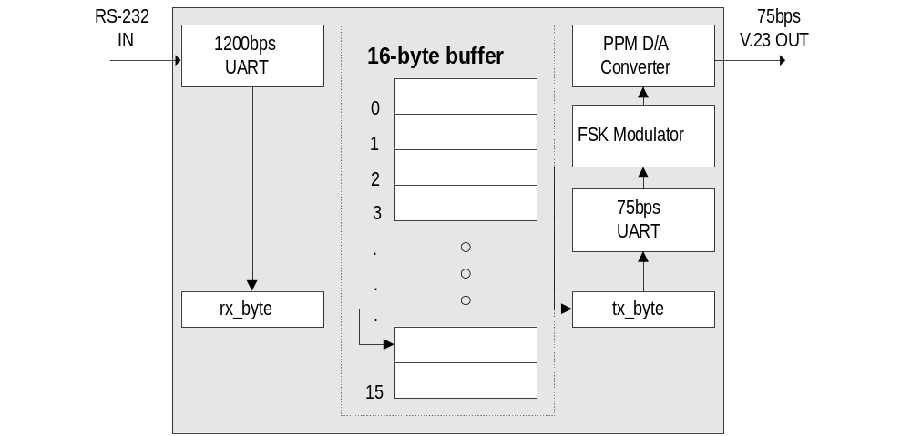
V.23 Transmit VP
V.23 Transmit Software Blocks (VP’s)
Notes:
FSK Input:
The software implementation of FSK detection is very simple. The transitions on the input pin are timed by the software. If the transitions occur within a specified time, then a high frequency is being detected, otherwise a low frequency is being detected. A high frequency corresponds to a binary ‘0’ and a low frequency corresponds to a binary ‘1.’
Since the software uses a Schmidt Trigger input on the SX, the input FSK signal must be amplified until clipping to trigger the Schmidt Trigger levels.
The FSK receiver also includes it’s own 1200baud receiver. Once the incoming FSK signal is converted to logic ‘1’s and ‘0’s, the incoming bit-stream is processed by the receiver. Once an entire byte is received, the fsk_rx_flag is set.

Slide 65
V.23 Modem Block Diagram
ISP
SX28AC
Core
ISP
Crystal
Tx
RS232
Driver
Tx
RS232
UART
Rx
Rx
DTMF
DAA
FSK
modem
D/A
A/D
RJ-11

Slide 66
Telephony: Signal Detection
Signal Detection:
Decoding DTMF

Slide 67
Telephony: Signal Generation
Simplified DTMF Detection
There are many different useable algorithms to perform DTMF detection, some with better performance than others.
One algorithm developed at Scenix Semiconductor simplifies the process of detecting DTMF, and it is implemented as a Virtual Peripheral, or a software peripheral that interfaces with the main program as if it were hardware.
This simple algorithm is more than adequate for many types of DTMF detection, yet it can be implemented on a fast 8-bit microcontroller.

Slide 68
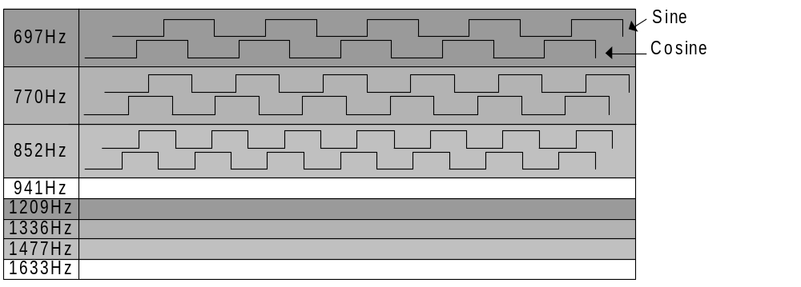
Telephony: Signal Generation
Simplified DTMF Detection
16 “sine” and “cosine” reference waves are generated in parallel at the frequencies to detect.

Slide 69
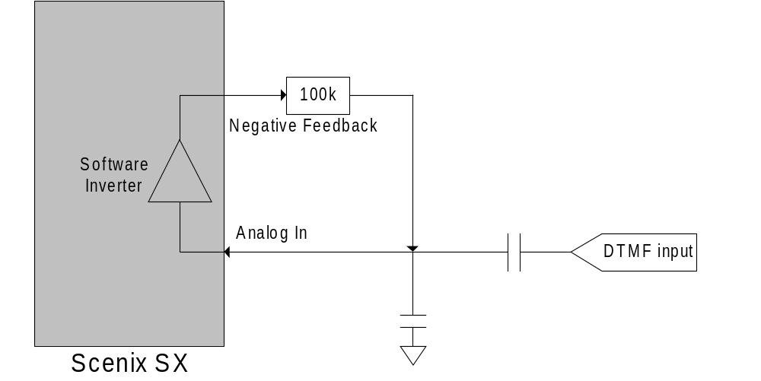
Telephony: Signal Generation
Simplified DTMF Detection
The DTMF input is normally the output of an op-amp and the negative feedback resistor is large. The result: With no signal, the negative feedback keeps the input pin at it’s CMOS threshold. When a signal is present at the DTMF input port, the SX creates an inverse, clipped version of it on the negative feedback pin.

Slide 70
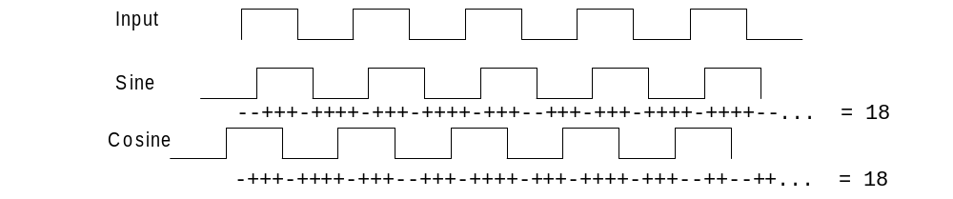
Telephony: Signal Generation
Simplified DTMF Detection
The simplified DTMF detection algorithm compares the input to the sine and cosine references, and increments or decrements each corresponding sine or cosine accumulator depending upon the result of the comparison.

Slide 71
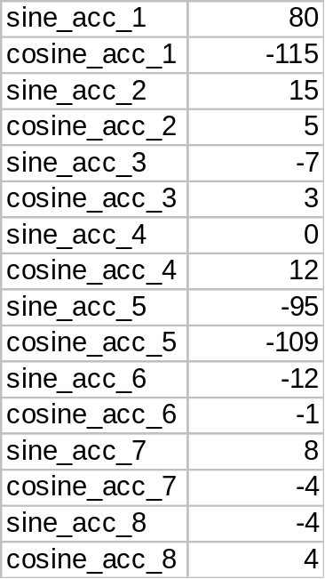
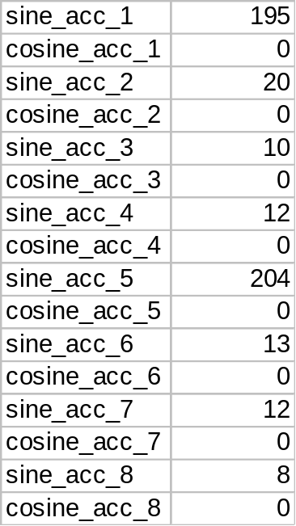
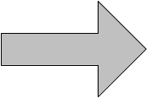
Telephony: Signal Generation
After detecting for a period of time (7 ~ 14ms for the Scenix SX solution), the processor then adds the absolutes of the sine and cosine accumulators for a final tally of the power that was present at each frequency. The two digits that exceed a certain threshold are “valid” as long as no other extraneous frequencies exceed the threshold.

Slide 72
Thank You

